Slide 1
Return to Pedigree Studies
Why GWAS and vGWAS should deploy family-models
Dalton Conley
NYU & NBER

Slide 2
GREML
Genomic-Related-Matrix Restricted Maximum Likelihood:
Estimating heritability directly from genome-wide data
  Use genome-wide data to estimate genetic similarity between pairs of unrelated individuals (i.e. summed gametic correlation)
  Regress (ML estimation) phenotypic distance against genetic distance
Notes:
Correlate phenotypic similarity with genotypic similarity across the genome among pairs of individuals who are less than 2.5% related as computed by identity by state and are therefore considered non-kin. Simply described, a genetic relatedness matrix is constructed in which each cell is filled by a measure of genotypic correlation between pairs of individuals (the rows and columns) where the genotype is based on the summation of 2N gametic correlation at specific loci across the genome, after pruning single nucleotide polymorphisms for linkage disequilibrium. The genotypes are coded as the numbers of minor alleles for each single nucleotide polymorphism, standardized by a transformation that makes the sample variance independent of allele frequency. The genetic relatedness matrix may then be used in concert with a phenotypic distance matrix to estimate heritability without estimating the phenotypic effect of any individual single nucleotide polymorphism locus.

Slide 3
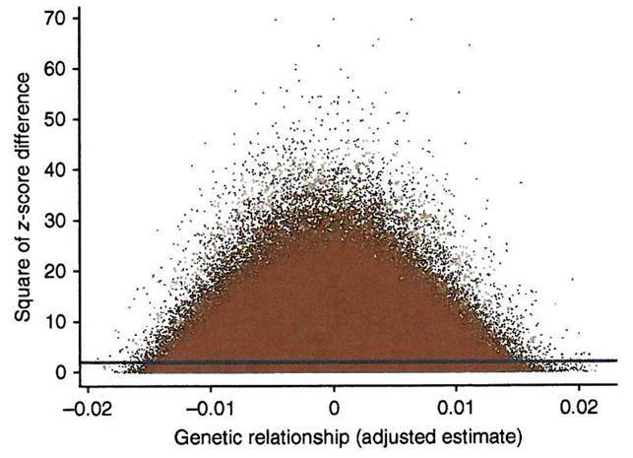
Regression of Height Differences against Genetic Relatedness
Notes:
All pairwise comparisons contribute to the estimate of genetic variance. Shown are the squared z-score differences between individuals ( Δy2jk) plotted against the adjusted estimates of genetic relationship ( A∗jk). The blue line is the linear regression line of Δy2jk on A∗jk. The intercept and regression coefficient are estimates of twice the phenotypic variance and minus twice the genetic variances23, respectively. The intercept is 1.98 (s.e. = 0.001) and the regression coefficient is −1.01 (s.e = 0.27), consistent with estimates of the phenotypic and additive genetic variance of 0.990 and 0.505, respectively, and a proportion of variance explained by all SNPs of 0.51.

Slide 4
Key Identifying Assumption:
Among individuals who are unrelated environmental factors are uncorrelated with differences in their degree of genetic similarity, which itself results from random differences in the recombination and segregation of alleles

Slide 6
Type II Error: Kolmogorov-Smirnov Test (p-value = 7.037e-08)

Slide 7
HRS Analytic Sample:
6,414 ~ 24,030,580 pairs
 | h² 2 PCs A | h² 10 PCs B | h² 25 PCs C
Urban Childhood N=6,439 | .29155 [.0574] | .14767 [.0622] | .13787 [.0626]

Slide 8
GREML Results
 | h² No controls (2 PCs) A | h² Urban Control (2 PCs) B | |Δ| A - B
Height | .324887 [.064356] | .325102 [.064346] | .000215 [.091006]
BMI | .313004 [.067359] | .313230 [.067428] | .000226 [.095309]
Education | .174930 [.065012] | .152170 [.065222] | .022760 [.092089]

Slide 9
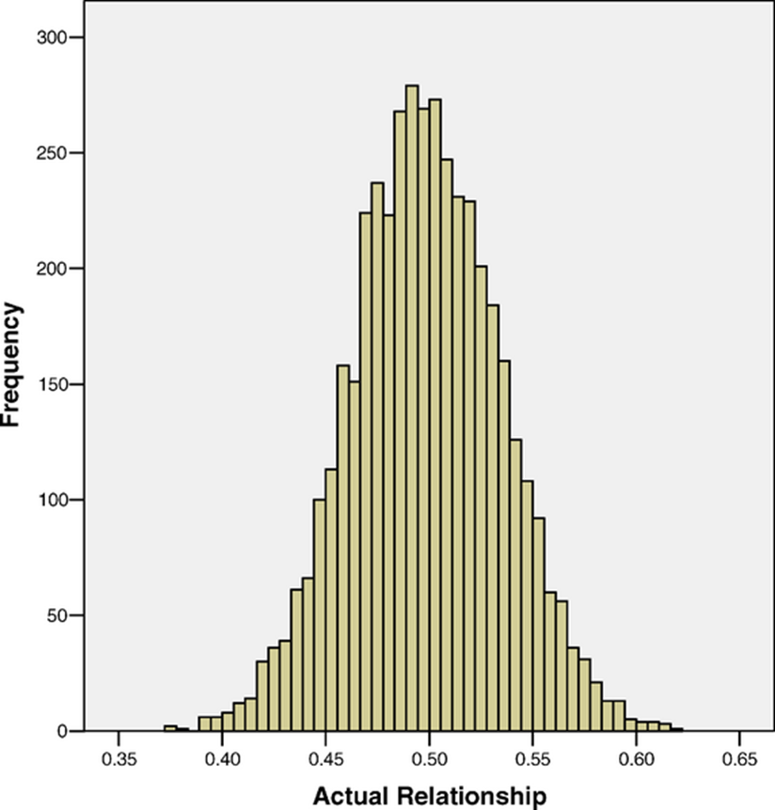
Sibling IBD

Slide 10
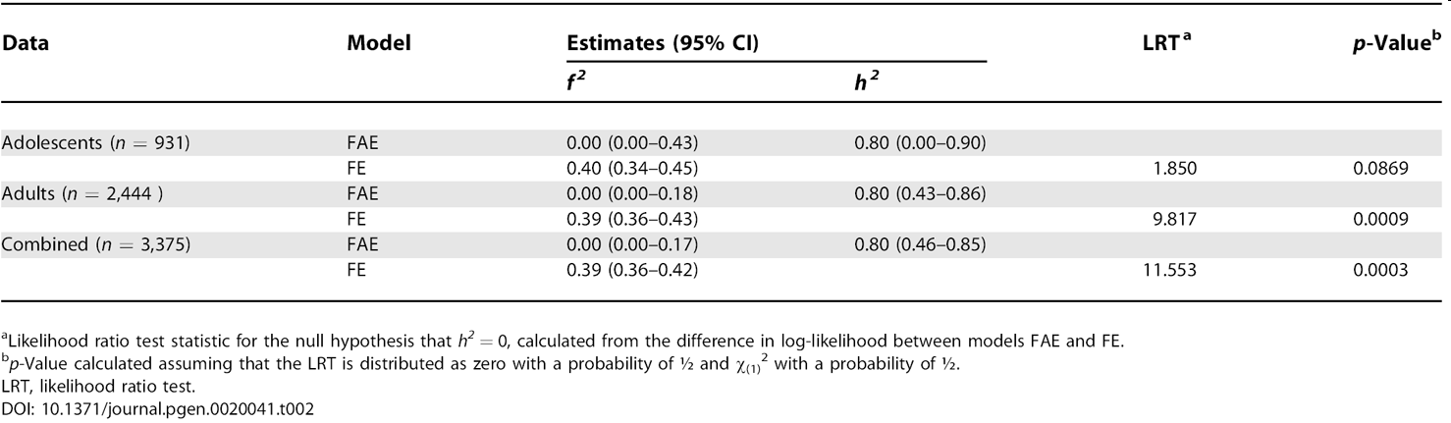
IBD Estimates of Height Heritability

Slide 11
Genetic Risk Scores:
Also Confounded?

Slide 12
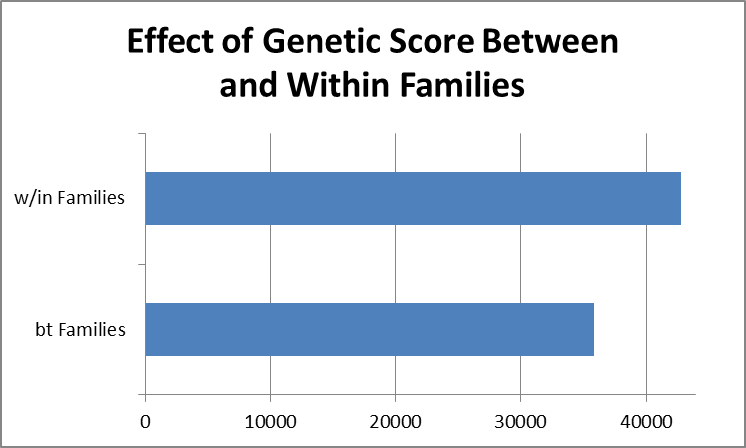
Framingham Heart Study: Highest Grade Completed

Slide 13
Modeling the error term in GWAS with vGWAS
The Search for Phenotypic Stablizers
and latent GxE / GxG

Slide 14
Yang et al. 2012: Manhattan Plot
FTO
RCOR1
-log(pval)
Chromosome

Slide 15
A better approach:
Family based analysis of
sibling standard deviation with controls for parental genotype

Slide 16
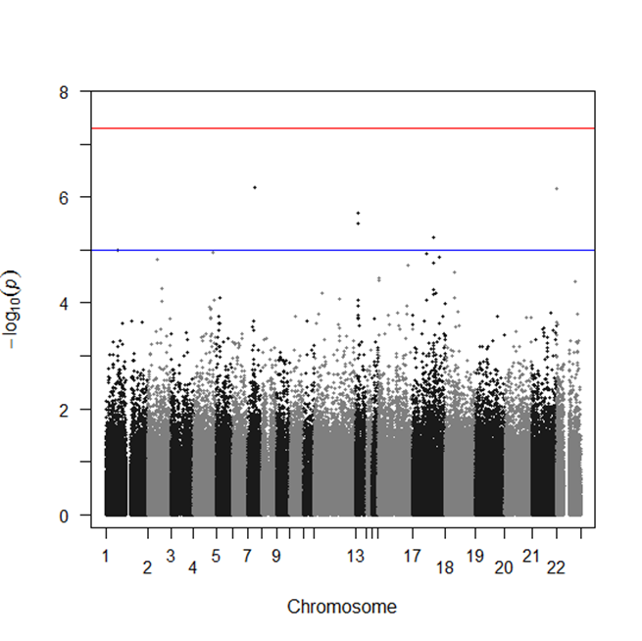
Framingham Heart Study: vGWAS of Sibling SD in Height
Controls for parental genotype; N= 1573

Slide 17
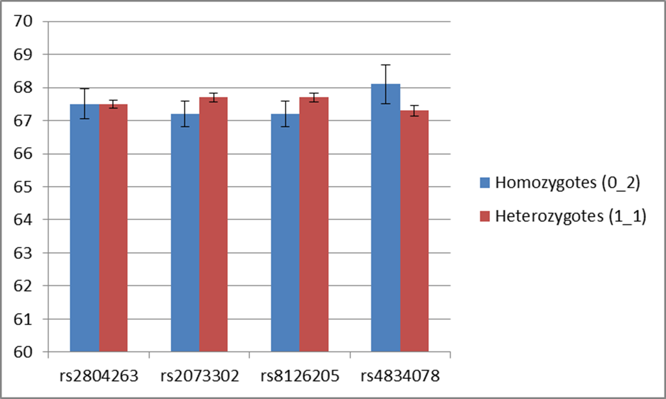
Is effect an artifact of dominance?

Slide 18
Problems Identified
Focus has been on adequate sample size for genome-wide associations at expense of careful consideration of confounding
  GREML key assumption is violated
  Future GREML analysis must include robustness checks for co-segregation of environment
Typical population based modeling of vGWAS has no way of untangling mean / variation effects

Slide 19
Alternative Approach
Combine old-fashioned pedigree analysis with new GWAS association studies to create within-family models where genotype is randomized
Using this approach, we can account for both mean & variation genetic effects with complete orthogonality to environment

Slide 20



Thanks!
NYU Bio: Mark Siegal & Siegal Lab; Justin Blau, Richard Bonneau, Tomas Kirchoff & Michael Purugganan
Others: Emily Rauscher, David Cesarini, Chris Dawes, Ben Domingue, Jason Boardman, Patrick Magnusson, Kathleen Harris, Matthew McQueen, Ofer Tchernichovski

