Slide 1
GWAS Panel
Jason Fletcher
Associate Professor
Public Affairs, Sociology, and
Applied Economics
University of Wisconsin-Madison

Slide 2
Background
Consumer of GWAS, not a producer
I think the Science GWAS on educational attainment was excellent and important
Main interest is using results from GWAS for GxE analysis

Slide 3
Opinions/discussion on:
Should we (social scientists):
Believe GWAS results?
Produce GWAS results?
Use GWAS results?
Are GWAS results a first step or a final step?

Slide 4
GWAS methods: Some key aspects
Fishing
Many tests, focus on small p-values
Amass large datasets to find small effect sizes
Focus on main effects
No GxG interactions; No GxE interactions
Causality
Temporality
Controls (esp for population stratification/confounding)
Replication
The limited degree of overlap with (good) social science methods of inquiry is striking
Notes:
Should we believe GWAS results?

Slide 5
Should additional social scientists be involved in GWAS?
Does the structure of the enterprise suggest a natural monopoly?
Large fixed costs, limited methodological or theoretical innovation from social science
Do we need a second social science genetic association consortium?
What is the value added by social scientists to the enterprise?
Phenotype selection
(Some) statistical suggestions
?
Does GWAS use any of our comparative advantages?
Could it?
Notes:
Should we produce GWAS results?

Slide 6
Should social scientists care about genetic discovery through GWAS?
How should we use GWAS findings?
Measuring latent variables
Attempts at providing upper bounds of genetic effects (?)
Use in GxE analysis to examine heterogeneity of effects of social science interest

Slide 7
GWAS hits; next steps
Animal/mechanistic models
Narrow down to candidate genes/loci
Can we contribute anything here?
Genetic Risk Score
Notes:
Are GWAS hits “enough”

Slide 8
Cautionary tale about genetic risk scores
Context:
Question: do genetic factors moderate the effect of tobacco taxes on tobacco use? (GxE)
NHANES data (1990-1994)
Phenotype: tobacco use
Genotype: two nicotinic receptor genes (CHRNA3, CHRNA6); two SNPs
“Environment”: State level tobacco taxation levels

Slide 9
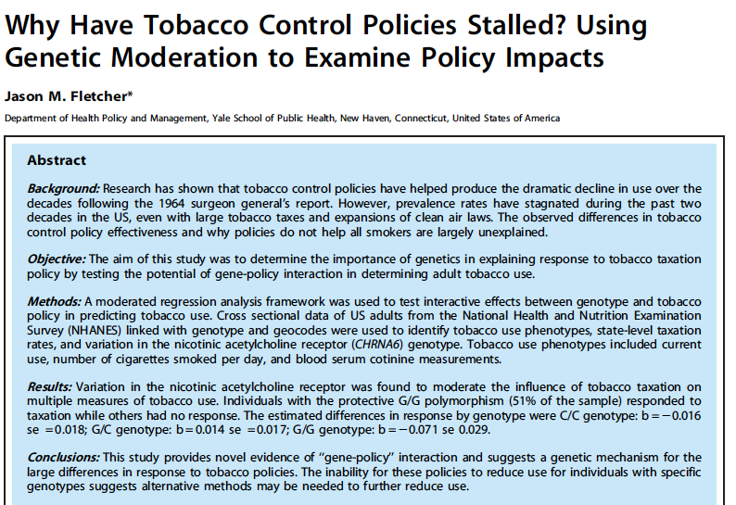

Slide 10
Construct (basic) genetic score
Main effects of each additional protective allele (GG/CHRNA6, CC/CHRNA3)
Zero score: 30% smoking likelihood
1 score: 24% smoking likelihood
2 score: 21% smoking likelihood
GxE Finding:
No evidence of interaction with the environmental exposure (i.e. no GxE)

Slide 11
However
Individually, the SNPs show strong interactions with taxation levels
In opposite directions; consistent with what is known about potential mechanisms of the different genes
CHRNA6—dopamine response to nicotinic exposure
CHRNA3—a “brake signal” in our brain to stop nicotine exposure
Suggests policies and genetic factors can be “substitutes” or “complements”
Key: We usually know very little about functioning of top SNP hits, much less genetic scores based on all SNPs
Result: False negatives in GxE analysis

Slide 12
Discussion
GWAS
Believe results?
Produce new results on social science outcomes?
Use results in social science work?

Slide 14
Imperialism
Comparative advantage

